Slide 1


The Haptic Glove Development Project
Levi Graham and Riley Nichols

Slide 2
Slide Overview
The team
Project Summery
Parts
The Process
Sprints 1-2
Sprints 3-5
Sprints 6-8
Sprints 9-11
Issues Encountered
Future Improvements
Demo
Photos
Questions

Slide 3
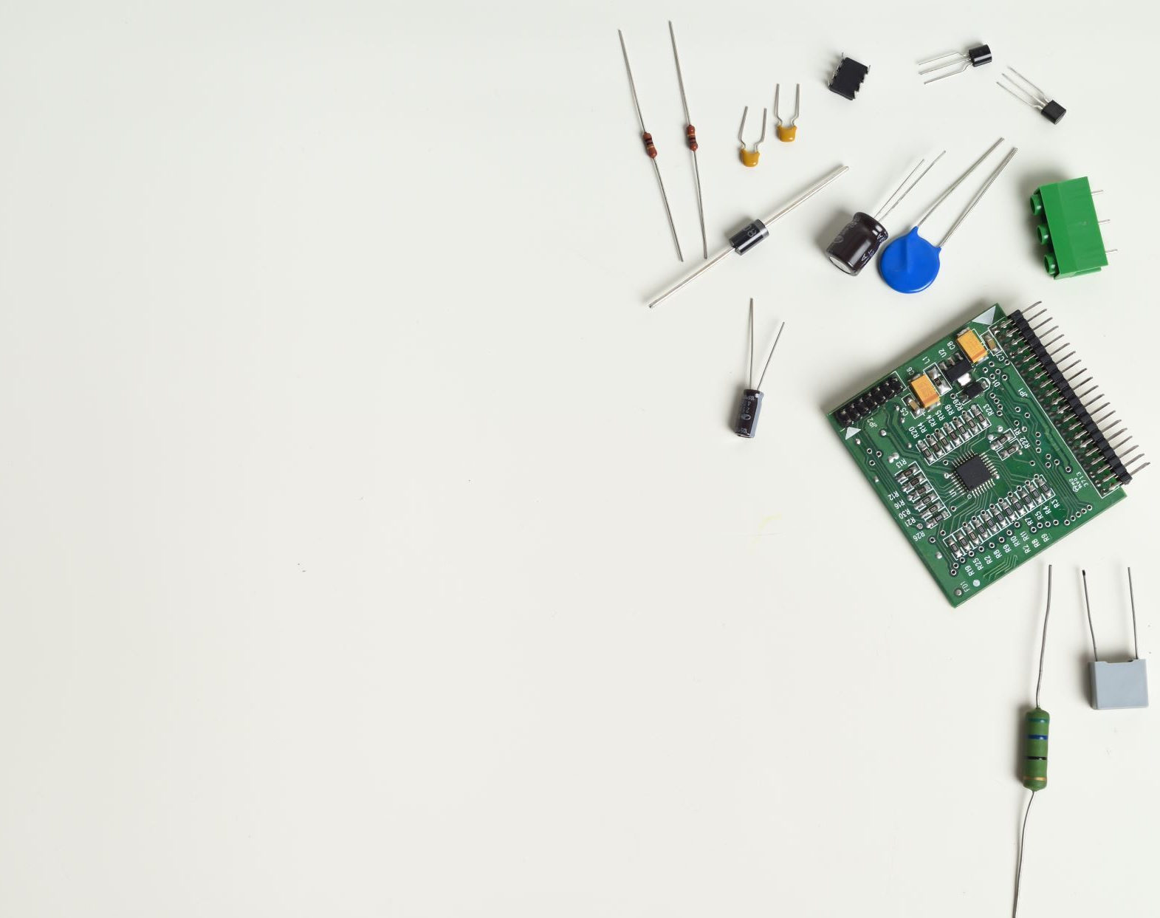
The Team
Levi Graham
Scrum Coach
Technical Lead (Software)
Riley Nichols
Technical Product Manager
Technical Lead (Hardware)

Slide 4
The Project
The goal of the project was to develop a Haptic Glove that allow user hand readings to be wirelessly sent to a computer, where they can be read and interpreted.
We aslo wanted to use parts and materials that were both easy to access and provide easy instructions to allow anyone to experiment and build their own designs.

Slide 5
Parts
Part Name | Quantity
Arduino R3 Uno | 1
Long Flex Sensors | 4
Short Flex Sensors | 1
IMU (Inertail Measurment Unit) | 1
Multiplexer | 1
Bluetooth Module (HC-06) | 1
22-Gauge Wire | Enough
PCB (Printable Circuit Board) | 1
*This does not include non-electronic parts and materials such as the Glove itself or the materials needed to attach this to a glove.

Slide 6
The Process (Sprints 1-2)
The First Two Sprints was primarily Research based.
Sprint 1 was part research and ordering
Sprint 2 was program research and testing.
A lot of the parts and programs we initially thought we would stick with fell through, such as a replacement for flex sensors, arduino and Unity.

Slide 7
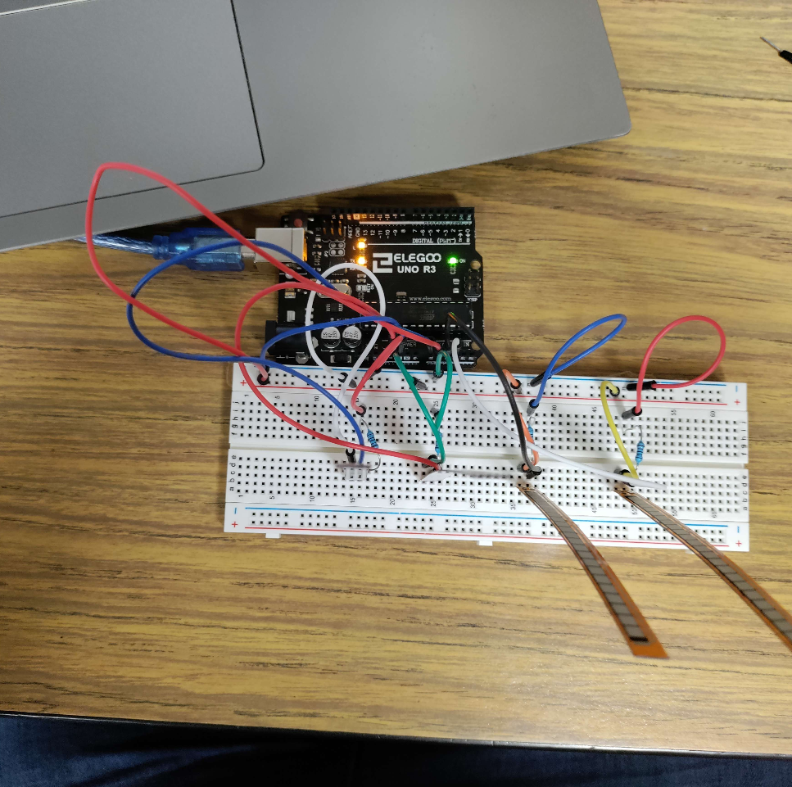
The Process (Sprints 3-5)
Sprints 3-5 were primarily testing and understanding each of the individual parts and sensors
Sprint 3 focused on testing each sensor, and making sure they worked independent of one another
Sprint 4 looked at combinging the sensors together into a single working circuit
Sprint 5 wrapped up Sprint 4 and looked at improving response time between the arduino and the computer.

Slide 8
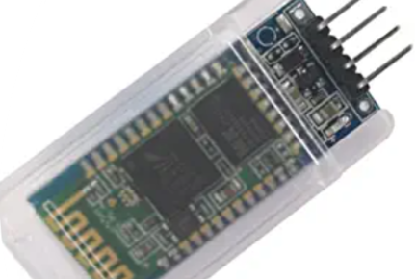
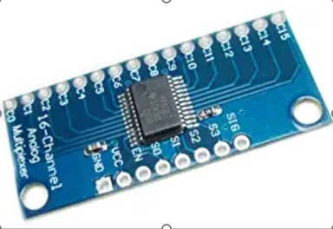
The Process (Sprints 6-8)
Sprint 6-8 was primarily about bluetooth conectivity
We ran into the most issues when trying to implement bluetooth fully into our design, and it took multiple sprints to successfully add
We also implemented our multiplexer, which fixed our issue of not enough pins to support each sensor.

Slide 9
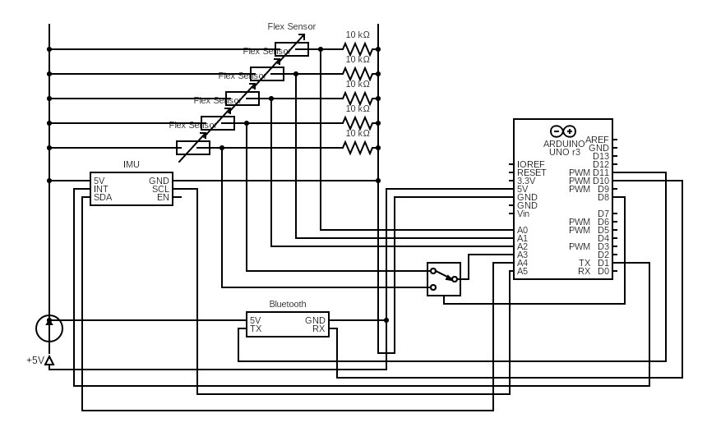
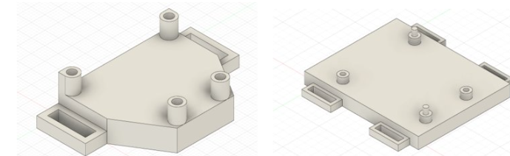
The Process (Sprint 9-11)
These last three sprints involved the soldering of the completed circuit design
Sprint 9 primarily involved the drawing of the circuit design, the ordering of the PCB board, and the building of the 3D printed parts.
The last 2 sprints involved the actual soldering of the circuit and testing the readings to ensure accurate wireless communication

Slide 10

Issues of the Project/Lessons Learned
Working with Bluetooth
Parts Selection
More sensors than controller support
Glove software driver development

Slide 11
Future Improvements
Change the glove driver to allow easier conversion between projects
Improvement to Glove design to allow more comfort for the user
Improvements in glove simplicity for easier user usage

Slide 12
Demo

Slide 13

Questions?

